Slide 1
PHP Web Services
Presented by : Sushil Wanjari

Slide 2
Agenda
What is a Web Service?
How Does it Work?
SOAP
REST
Web Services and PHP
cURL

Slide 3
What is a Web Service?
A web service is a software system designed to support interoperable machine-to-machine interaction over a network – W3C
A web service is a service offered by an electronic device to another electronic device, communicating with each other via the World Wide Web – Wikipedia
Method of communication between two electronic devices over Web
Why Web Services are used?
Where it is used?
Notes:
1995 / 2004 / 2015

Slide 4
How Does it Work?
Communicates on a protocol such as HTTP to perform machine-to-machine communication
Transfers machine readable data such as XML and JSON
Typically provides an Object Oriented web-based interface to a database server; Utilized by another web server or a mobile application that may provide a user interface to the end user
Mashup – A Web Server consumes several web services from different servers and compiles the content into one user interface
SOA Introduction
Notes:
1995 / 2004 / 2015

Slide 5
SOAP
Simple Object Access Protocol
Protocol specification for exchanging structured information in the implementation of web services
Uses XML information set for its message format
Relies on protocols like HTTP, SMTP for message transmission
Notes:
1995 / 2004 / 2015

Slide 6
SOAP
XML based protocol consisting of
  Envelope – Identifies the XML document as a SOAP message
  Header – Contains header information
  Body – Contains call, and response information
  <?xml version="1.0"?>
  <soap:Envelope xmlns:soap="http://www.w3.org/2003/05/soap-envelope" xmlns:m="http://www.example.org/stock/Manikandan">
  <soap:Header> </soap:Header>
  <soap:Body>
  <m:GetStockPrice>
  <m:StockName> GOOGLE </m:StockName>
  </m:GetStockPrice>
  </soap:Body>
  </soap:Envelope>
Notes:
1995 / 2004 / 2015

Slide 7
REST
Representational State Transfer
Way of providing interoperability between computer systems on the internet
Allows accessing and manipulating web resources using an uniform and predefined set of stateless operations
Performance, Scalable, Simple, Modifiable, Visible, Portable, Reliable
Client-server architecture, Stateless, Cacheable, Layered, Uniform interface
Web Services adhering to REST architecture are called RESTful APIs
Notes:
1995 / 2004 / 2015

Slide 8
REST
Defined with
  URL
  HTTP Method
  Media Type
URL | GET | PUT | POST | DELETE
https://api.example.com/users | Get the list of all users | Replace all the users with the new collection | Create a new user | Delete all the users
https://api.example.com/users/123 | Get the user with ID 123 | Update the details of user with ID 123 | - | Delete the user with ID 123
Notes:
1995 / 2004 / 2015

Slide 9
Web Services And PHP
Server
  Routing + Method Detections
  Parameter Extraction
  Preparing Response
  Return Response
  Authentication & Authorization, Logging, Performance, Security etc…
  $_SERVER[]
Client
  Prepare URL
  Add Parameters
  Call
  Receive Response
  Handle Response
  curl()
FRAMEWORKS
Notes:
1995 / 2004 / 2015

Slide 10
cURL
libcurl
  Library that allows to connect and communicate to many different types of servers with many different types of protocols
  Supports http, https, ftp, gopher, telnet, dict, file and ldap protocols
  Also supports HTTPS certificates and HTTP / FTP uploading, proxies, cookies and authentication
  PHP cURL – Wrapper on top of libcurl
Notes:
1995 / 2004 / 2015

Slide 11
cURL
curl_version() — Gets cURL version information
curl_init() — Initialize a cURL session
curl_setopt() — Set an option for a cURL transfer
curl_setopt_array() — Set multiple options for a cURL transfer
curl_exec() — Perform a cURL session
curl_getinfo() — Get information regarding a specific transfer
curl_close() — Close a cURL session
curl_errno() — Return the last error number
curl_error() — Return a string containing the last error for the current session
Notes:
1995 / 2004 / 2015

Slide 12
cURL
Steps
  Initialize a cURL session using curl_init()
  Set transfer options using curl_setopt()
  Execute the session using curl_exec()
  Close the session using curl_close()
Notes:
1995 / 2004 / 2015

Slide 13
cURL - Execute
<?php
// create a new cURL resource
$ch = curl_init();
// set URL and other appropriate options
curl_setopt($ch, CURLOPT_URL, "http://www.example.com/");
curl_setopt($ch, CURLOPT_RETURNTRANSFER, 1);
// grab URL and pass output to a variable
$output = curl_exec($ch);
// close cURL resource, and free up system resources
curl_close($ch);
?>
Notes:
1995 / 2004 / 2015

Slide 14
cURL – Error Handling
<?php
// Create a curl handle to a non-existing location
$ch = curl_init('http://404.php.net/');
// Execute
curl_setopt($ch, CURLOPT_RETURNTRANSFER, true);
curl_exec($ch);
// Check if any error occurred
if(curl_errno($ch))
{
echo 'Curl error: ' . curl_error($ch);
}
// Close handle
curl_close($ch);
?>
Notes:
1995 / 2004 / 2015

Slide 15
cURL – Get Info
<?php
// Create a cURL handle
$ch = curl_init('http://www.example.com/');
// Execute
curl_exec($ch);
// Check if any error occurred
if (!curl_errno($ch)) {
$info = curl_getinfo($ch);
echo 'Took ', $info['total_time'], ' seconds to send a request to ', $info['url'], "\n";
$http_code = curl_getinfo($ch, CURLINFO_HTTP_CODE)
}
// Close handle
curl_close($ch);
?>
Notes:
1995 / 2004 / 2015

Slide 16
cURL – HTTP POST
<?php
$params=['name'=>'John', 'surname'=>'Doe', 'age'=>36)
$defaults = array(
CURLOPT_URL => 'http://myremoteservice/',
CURLOPT_POST => true,
CURLOPT_POSTFIELDS => $params,
);
$ch = curl_init();
curl_setopt_array($ch, $defaults);
curl_exec($ch);
curl_close($ch);
?>
Notes:
1995 / 2004 / 2015

Slide 17
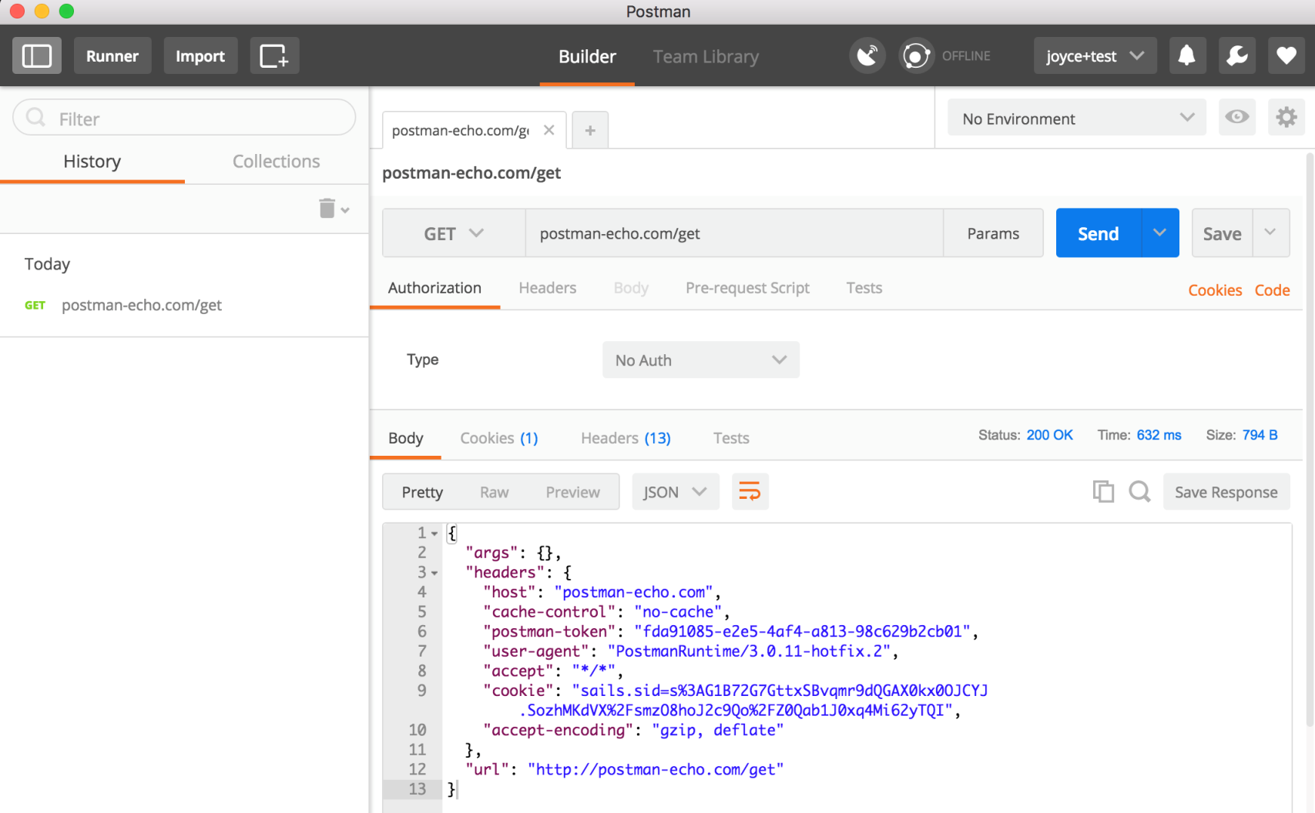
Postman
Postman REST Client
Notes:
1995 / 2004 / 2015

Slide 18
Any Questions?

